Slide 1
Sax Parsing Display Employees Example 2
Lecture 6e
Lecturer: Jackie Stewart
Email: jackiestewart@ait.ie
Jackie.stewart@tus.ie

Slide 2
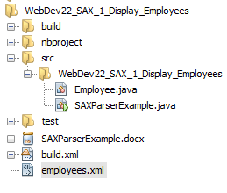
Display Employees
Create Java Project in Netbeans
Create 2 classes
Employee.java - Java Bean object
SaxParserExample – Main class
Xml document to be parsed is “employees.xml”

Slide 3
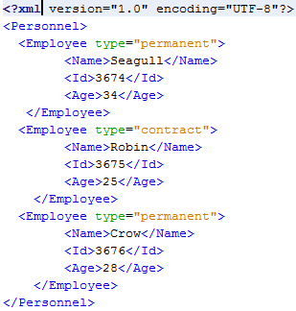
Employee.xml
Personnel root element
Containing multiple Employee Elements
Employee Element contains name Attribute
Employee Element contains child elements:
Name
Id
Age

Slide 4
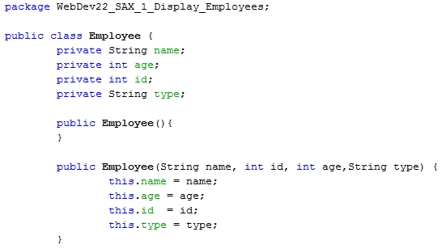
Employee – Bean object (used to create an instance of an Employee)
Holds Employee Object Data
Contains constructor
Sets name, age, id, type
Getter / setter methods for each (not included in screenshot)
toString method
Overrides string base method to print out Employee data in custom format

Slide 5
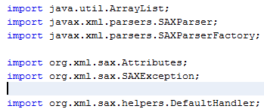
SaxParserExample
Imports required:

Slide 6

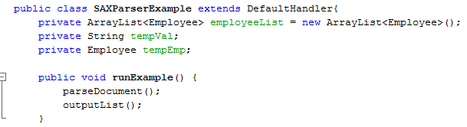
SaxParserExample
Extends DefaultHandler
Main Method
SaxParserExample 2 separate methods:
parseDocument()
outputList()

Slide 7
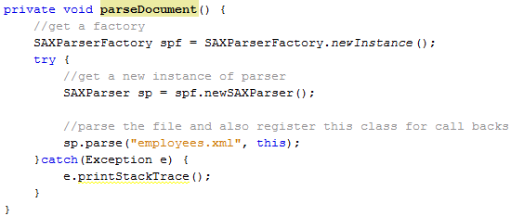
parseDocument
New SAXParserFactory created from newInstance (singleton)
SAXParser created fromFactory
Call sp.parse method passing in file name. This loads contents into memory

Slide 8
Event Handlers
Overrides DefaultHandler methods:
startElement
endElement
Characters
This means we get a ‘callback’ when the parser encounters one of these elements
Example: When parser finds <Name>, it will call the startElement method

Slide 9
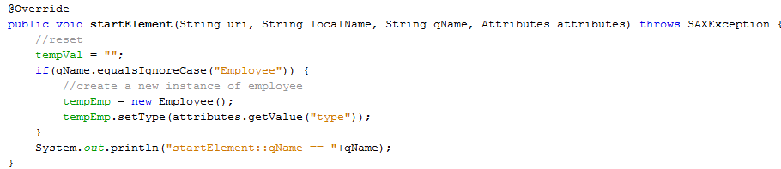
startElement
Using params such as qName we can look for current opening ‘tag’
If Employee is found
Create new Employee object (to hold the data)
Get Type attribute using attributes param

Slide 10

charsElement
Using params character array, start, length
Create new String
Store string as ‘tempVal’

Slide 11
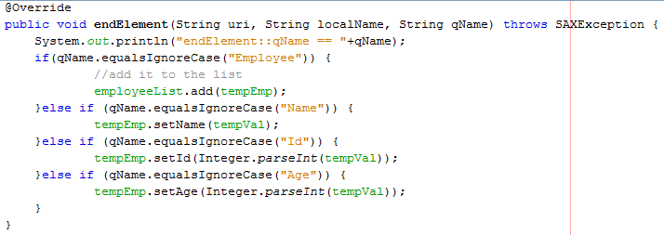
endElement
Using params such as qName we can look for current closing ‘tag’
If Employee is found
add Employee object to the List
If Name, Id or Age is found, set the value using ‘tempVal’

Slide 12
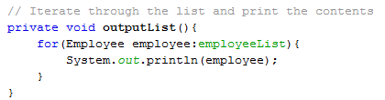

Output Data
Loops through ‘employee’ list
Note: printed out in our custom format as we overwrote toString method !

